Slide 1
Chapter 10 File-System Interface

Slide 2
教学内容、目标与要求
教学内容
文件系统概述
文件概念
访问方法
目录结构
文件系统安装
文件共享与保护
教学重点
2、3、4
教学目标与要求
理解文件系统功能；
了解文件系统接口；
了解文件系统保护。

Slide 3
Overview of File Management
File Management
File management system is considered part of the operating system.
Input to applications is by means of a file.
Output is saved in a file for long-term storage.
File Management System
The way a user of application may access files.
Programmer does not need to develop file management software.

Slide 4
Minimal Set of Requirements
Each user should be able to
create, delete, read, and change files.
restructure the user’s files in a form appropriate to the problem.
move data between files.
back up and recover the user’s files in case of damage.
to access the user’s files by using symbolic names.
Each user may
have controlled access to other users’ files.
control what type of accesses are allowed to the users’ files.

Slide 5
File Management Functions
Identify and locate a selected file.
Use a directory to describe the location of all files plus their attributes.
On a shared system describe user access control.
Blocking for access to files.
Allocate files to free blocks.
Manage free storage for available blocks.

Slide 6
Objectives for File Management System
Meet the data management needs and requirements of the user.
Guarantee that the data in the file are valid.
Optimize performance
Provide I/O support for a variety of storage device types.
Minimize or eliminate the potential for lost or destroyed data.
Provide a standardized set of I/O interface routines.
Provide I/O support for multiple users.

Slide 7
Contents
10.1 File Concept
10.2 Access Methods
10.3 Directory Structure
10.4 File System Mounting
10.5 File Sharing
10.6 Protection

Slide 8
10.1 File Concept
OS provides a uniform logical view of information storage.
A file is a named collection of related information that is recorded on secondary storage.
A file is the smallest allotment of logical secondary storage.
Commonly, files represent programs and data.
Program: source, object
Data files: numeric, character, binary
files may be free form or may be formatted rigidly.
Contiguous logical address space.
The information in a file is defined by its creator.
A file is named, and is referred to by its name, and is independent.

Slide 9
File Attributes
File Attributes
Name – only information kept in human-readable form.
Identifier – a unique number that identifies the file within the system, non-human-readable name for the file.
Type – needed for systems that support different types.
Location – a pointer to the location of the file on device.
Size – current size of the file.
Protection – access-control information, controls who can do reading, writing, executing.
Time, date, and user identification – data for protection, security, and usage monitoring.
kept in the directory structure, which is maintained on the disk.
A directory entry consists of the file's name and its unique id. The id in turn locates the other file attributes.

Slide 10
File Operations
A file is an abstract data type.
The minimal set of required file operations
Create – find space, make an entry in directory for the file.
Write – file name, information to be written. write pointer.
Read – file name, position in memory, read pointer. A per-process current-file-position pointer.
Reposition within file – file seek, not need I/O.
Delete – file name, release file space, erase directory entry.
Truncate – reset length to 0, release file space.
These primitive operations may be combined to perform other file operations. e.g. Copy
Most file operations involve searching the directory for the entry associated with the named file.

Slide 11
File Operations
Open-file table
A kernel data structure.
containing information about all open files.
Open(F_{i})
search the directory structure on disk for entry of F_{i}
move the content of the entry to open-file table.
Return a pointer to the entry in the open-file table.
also accept access mode information, such as create, read-only, read-write, append-only, etc.
Close (F_{i})
move the content of entry F_{i} in open-file table to directory structure on disk.

Slide 12
File Operations
File sharing
Several processes may open the file at the same time.
Several different applications open the file at the same time.
Two levels of internal tables:
Process open-file table, a per-process table
tracks all files a process has open.
Keeps information regarding the use of the file by the process. e.g. the current file pointer, access rights, accounting information, etc.
System open-file table, a system-wide table
contains process-independent information, such as file location on disk, access dates, file size.
Each entry in the per-process table in turn points to a system-wide open-file table.

Slide 13
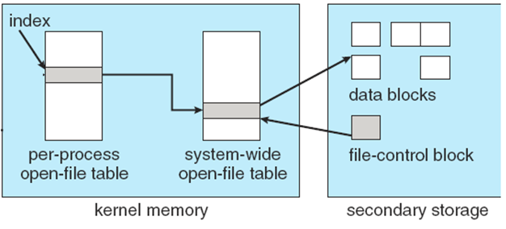
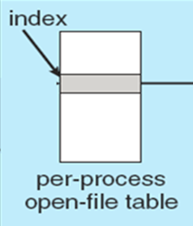
The two levels of open-file tables
2
Information ：
file pointer -- process
access rights -- process
disk location of the file -- system
file-open count -- system

Slide 14
Open File Locking
File locks allow one process to lock a file and prevent other processes from gaining access to it.
Provided by some OSs and file systems
Similar to reader-writer locks
Shared lock similar to reader lock – several processes can acquire concurrently.
Exclusive lock similar to writer lock.
Mediates access to a file
either mandatory or advisory file-locking mechanisms:
Mandatory – access is denied depending on locks held and requested. -- Windows OS.
Advisory – processes can find status of locks and decide what to do. -- Unix OS.
Notes:
if the locking scheme is mandatory, the operating system ensures locking integrity.
For advisory locking, it is up to software developers to ensure that locks are appropriately acquired and released.
Windows operating systems adopt mandatory locking, and UNIX systems employ advisory locks

Slide 15
File types
Whether the operating system should recognize and support file types?
A common technique for implementing file types is to include the type as part of the file name. (extensions)
name is split into two parts: a name and an extension, separated by a period character.
The system uses the extension to indicate the type of the file and the type of operations that can be done on that file.
Application programs also use extensions to indicate file types in which they arc interested.
Some OS, each file has a type and a creator attribute containing the name of the program that created it.
UNIX, a magic number stored at the beginning of some files to indicate roughly the type of the file.
.exe Linux, 0x7f45 AIX, 0x01df

Slide 16
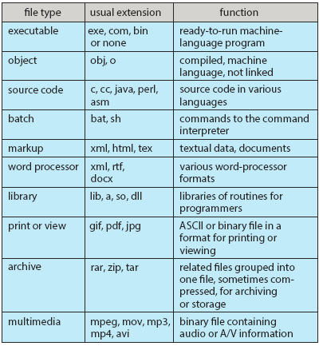
File types

Slide 17
File Structure
None - sequence of words, bytes
Simple record structure
Lines
Fixed length
Variable length
Complex Structures
Formatted document
Relocatable load file
Can simulate last two with first method by inserting appropriate control characters.
Who decides？
Operating system
Program

Slide 18
Internal file structure
Logical structure
Two types
Text file: a sequence of 8-bit bytes
Record file: a sequence of records with fixed or variable length
Logical address
Offset from the beginning of the file
Logic record no.
Physical structure: A set of disk blocks.
Basic I/O functions operate in terms of blocks.
Mapping logical address to physical address
Logical block no.
Physical disk block no.
Offset in block.
Internal fragmentation
The logical record size, physical block size, and packing technique determine how many logical records are in each physical block.
disk space is always allocated in blocks

Slide 19
10.2 Access Methods
Reflect different file structures.
Different ways to store and process data.
Criteria for File Organization
Rapid access
Needed when accessing a single record
Not needed for batch mode
Ease of update
File on CD-ROM will not be updated, so this is not a concern.
Economy of storage
Should be minimum redundancy in the data.
Redundancy can be used to speed access such as an index.
Simple maintenance
Reliability
The Pile
The Sequential File
Indexed Sequential File
Indexed File
The Direct, or Hashed File

Slide 20
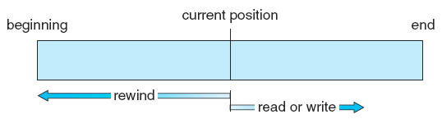
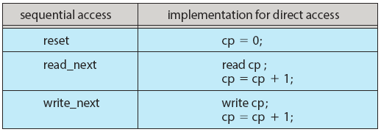
Access Methods
Sequential Access
read next
write next
reset
rewrite, no read after last write
sequential-access file
Direct Access
Read(n), Write(n)
Position(n)
read next, write next
Rewrite(n)
n = relative block number, the first is 0.
simulation of sequential access on a direct-access file.

Slide 21
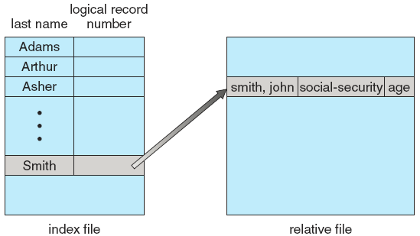
Other Access Methods
Can be built on top of a direct-access method.
General involve creation of an index for the file.
Keep index in memory for fast determination of location of data to be operated on.
If index is too large, two-level or multiple-level index files.
Example of index and relative files.

Slide 22
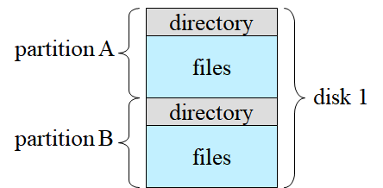
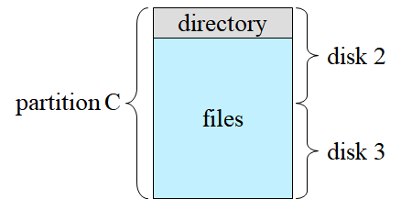
10.3 Directory Structure
Disk can be subdivided into partitions.
Each disk on a system contains at least one partition.
Some systems allow partitions to be larger than a disk to group disks into one logical structure.
Disk or partition can be used
raw, without a file system, e.g. swap space
formatted with a file system.

Slide 23
Directory Structure
Entity containing file system known as a volume.
Each volume containing file system also tracks that file system's info in device directory or volume table of contents.
Information such as name, location, size, and type is kept in entries in a directory.
Disks or partitions can be RAID protected against failure.
Redundant Arrays of Independent Drives，RAID

Slide 24
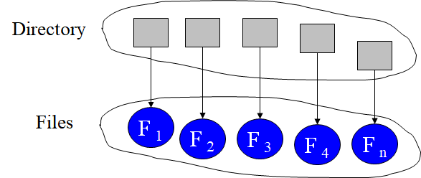
Directory Overview
A collection of nodes containing information about all files: Attributes, Location, Ownership.
Can be viewed as a symbol table that translates file names into their directory entries.
Provides mapping between file names and the files themselves.
Directory itself is a file owned by the OS.
Both the directory structure and the files reside on disk.

Slide 25
Information in a Directory Entry*
Name
Type
Location
Current length
Maximum length
Date last accessed (for archival)
Date last updated (for dump)
Owner ID (who pays)
Protection information

Slide 26
Operations Performed on a Directory
Search for a file
Create a file
Delete a file
List a directory
Rename a file
Traverse the file system

Slide 27
objects of organizing Directory
Efficiency
Locating a file quickly.
Naming
Convenient to users.
Two users can have same name for different files.
The same file can have several different names.
Grouping
Logical grouping of files by properties, e.g., all Java programs, all games, …

Slide 28
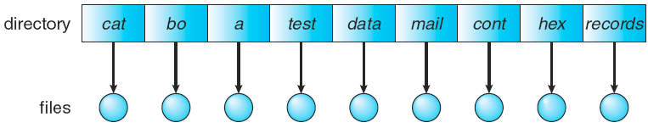
Single-Level Directory
All files are contained in the same directory.
List of entries, one for each file.
Sequential file with the name of the file serving as the key.
Naming problem
Files must have unique names.
The length of a file name.
Grouping problem

Slide 29
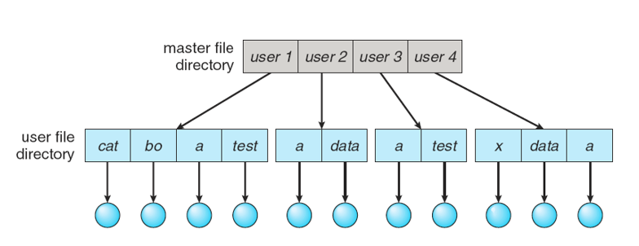
Two-Level Directory
Create a separate directory for each user.
A master file directory and one user file directory for each user.
Master file directory contains entry for each user, indexed by user name or account number. provides address and access control information.
Each user file directory is a simple list of files for that user.
Different users may have files with the same name.
Efficient searching.
No grouping capability.
File sharing?
Path name. defined by a user name and a file name.
Special user directory, containing system files.
Search path, the sequence of directories searched.

Slide 30
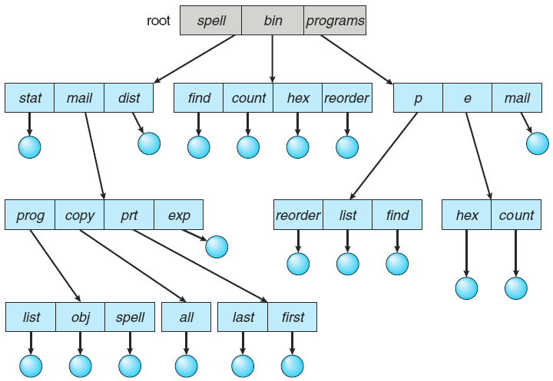
Tree-Structured Directories
the most common directory structure.
every file has a unique path name.
Allow users to create their own sub-directories and to reganize their files.
Each user directory may have one or more sub-directories and files as entries.
All directories have the same internal format. One bit in each entry defines the entry as a file(0) or as a subdirectory(1).
合理
方便
高效

Slide 31
Tree-Structured Directories
Efficient searching
convenient Naming
Grouping Capability
Current directory (working directory)
In accounting file, a pointer/the name of the user's initial directory.
Copied to a local variable for this user.
Change current directory: cd /spell/mail/prog
Absolute or relative path name
Creating a new file is done in current directory.
Delete a file: rm <file-name>

Slide 32
Tree-Structured Directories
Creating a new subdirectory is done in current directory.
mkdir <dir-name>
e.g. if in current directory /mail
mkdir count
mail
prog
copy
prt
exp
count
Deleting a subdirectory
deleting a empty directory. -- MS-DOS
deleting all files and subdirectories that it contains. -- UNIX
How to share files?
e.g. working on a joint project
方便，但危险

Slide 33
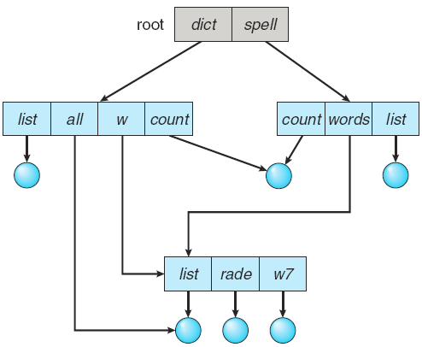
Acyclic-Graph Directories
Have shared subdirectories and files.
The same file or subdirectory may be in two different directories.
Note: a shared file/directory is not the same as two copies of the file/directory.

Slide 34
Acyclic-Graph Directories
Ways implementing shared files and subdirectories:
Create a new directory entry, called a link. -- UNIX link, a pointer to another file or subdirectory. e.g. path name
the directory entry is marked as a link.
Resolve the link – follow pointer to locate the file.
A link is clearly different from the original directory entry.
duplicate all information about shared files in all sharing directories.
Both entries are identical and equal.
the original and the copy indistinguishable.
Problem: maintaining consistency when a file is modified?

Slide 35
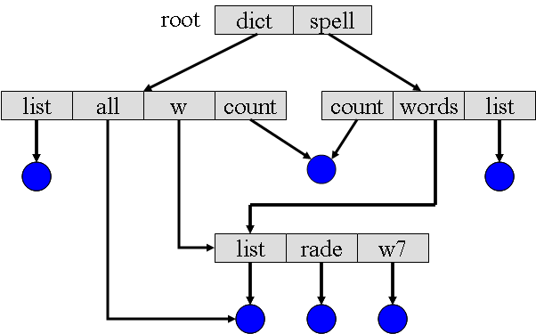
Acyclic-Graph Directories
Problems
A file may have multiple absolute path names. Distinct file names may refer to the same file. (aliasing problem)
Traverse the entire file system, accumulate statistics on all files, copy all files to backup storage.
Deletion of the shared file.
① Remove the file whenever anyone deletes it, dangling pointers. E.g. If dict deletes count
Links,
Deletion of a link need not affect the original file.
Deletion of the file entry, leaving the links dangling.
Duplication,
File-reference list, Backpointers.

Slide 36
Acyclic-Graph Directories
Problems(Cont.)
Deletion of the shared file (Cont.).
② Preserve the file until all references to it are deleted.
Solutions:
File-reference list
File-reference count
Backpointers, so we can delete all pointers. Variable size records a problem.

Slide 37
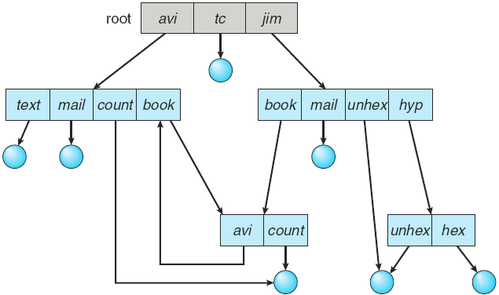
General Graph Directory
The primary advantage of an acyclic graph is the relative simplicity of the algorithms
to traverse the graph. Avoid searching the shared subdirectory twice.
to determine when there are no more references to a file.
A poorly designed algorithm might result in an infinite loop continually searching through the cycle and never terminating.

Slide 38
General Graph Directory
How to determine when a file can be deleted?
With acyclic-graph directory structures, when the value of of the reference count is 0.
With general graph directory structures, when cycles exist, the reference count may not be 0 even when it is no longer possible to refer to a directory or file.
This anomaly results from the possibility of self-referencing. ( cycle )
Solution, using Garbage collection.
The first pass, traversing the entire file system, marking everything that can be accessed.
The second pass, collects everything that is not marked onto a list of free space.

Slide 39
General Graph Directory
How to avoid cycles?
Allow only links to file not subdirectories. guarantee no cycles.
Every time a new link is added use a cycle detection algorithm to determine whether it is OK. Very expensive! especially when the graph is on disk storage.
A simpler algorithm, bypass links during directory traversal.

Slide 40
10.4 File System Mounting
A file system must be mounted before it can be accessed.
The mount procedure
The operating system is given the name of the device, and the mount point -- the location within the file structure at which to attach the file system.
The operating system verifies that the device contains a valid file system by asking the device driver to read the device directory and verifying that the directory has the expected format.
The operating system notes in its directory structure that a file system is mounted at the specified mount point.

Slide 41
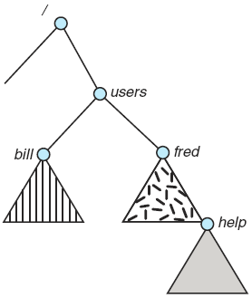
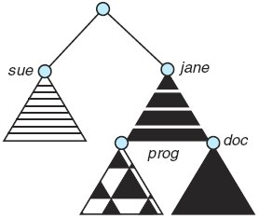
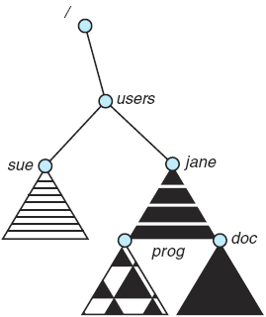
File System Mounting
Existing
Unmounted Partition
Mount point: users
Systems impose semantics to clarify functionality.
may disallow a mount over a directory that contains files.
may make the mounted file system available at that directory and obscure the directory’s existing files until the file system is unmounted, terminating the use of the file system and allowing access to the original files in that directory.
may allow the same file system to be mounted repeatedly, at different mount points.
may only allow one mount per file system.

Slide 42
10.5 File Sharing
Sharing of files on multi-user systems is desirable.
Sharing may be done through a protection scheme.
More file and directory attributes are needed.
File / directory owner
File / directory user, access rights
File / directory user groups, access rights
If multi-user system
User IDs identify users, allowing permissions and protections to be per-user. Group IDs allow users to be in groups, permitting group access rights.
Owner of a file / directory
Group of a file / directory
遵守规则
安全共享
保护机制
授权访问

Slide 43
Remote File Systems
Uses networking to allow file system access between systems
1st method: manually transferring files via programs like FTP.
used for both anonymous and authenticated access.
2nd method: using distributed file systems (DFS).
remote directories are visible from a local machine.
much tighter integration between the machine.
3rd method: automatically via the WWW.
A browser is needed.
uses anonymous file exchange.
Cloud computing is being used.
文明用网
产权保护

Slide 44
Failure Modes
All file systems have failure modes.
Local file system fails, reasons:
disk failure, disk-controller failure, cable failure, host-adapter failure.
corruption of directory structures or other non-user data, called metadata.
User or system-administrator failure
Remote file systems add new failure modes, due to
network failure, server failure
Recovery from failure can involve state information about status of each remote request.
If both server and client maintain knowledge of their current activities and open files, then they can seamlessly recover from a failure.
Stateless protocols such as NFS V3 include all information in each request, allowing easy recovery but less security.
In NFS V4, it is made stateful to prove its security, performance, and functionality.

Slide 45
Consistency Semantics
Consistency semantics specify how multiple users are to access a shared file simultaneously
Specify when modifications of data by one user will be observable by other users.
Similar to process synchronization algorithms of Chapter 6
Tend to be less complex due to disk I/O and network latency (for remote file systems).
UFS (Unix file system) implements:
A file is associated with a single physical image.
Writes to an open file visible immediately to other users of the same open file.
Sharing file pointer to allow multiple users to read and write concurrently.

Slide 46
Consistency Semantics
Consistency semantics specify how multiple users are to access a shared file simultaneously (Cont.)
AFS (Andrew File System) implemented complex remote file sharing semantics
The server records what its clients do and keeps the file information they are caching.
When a client changes a file, the server notifies other clients with a call back promise technique
Writes only visible to sessions starting after the file is closed.
Immutable(不变的) shared files, declared by its creator. Read-only.
Name may not be reused.
Contents may not be altered.

Slide 47
10.6 Protection
Reliability -- duplicate copies of files
Protection -- controlled access.
File owner/creator should be able to control:
what can be done, by whom
Types of access
Read -- read from the file.
Write -- write or rewrite the file.
Execute -- load the file into memory and execute it.
Append -- write new information at the end of the file.
Delete -- delete the file and free its space for possible reuse.
List -- list the name and attributes of the file.
Other operations, such as renaming, copying, or editing the file, may also be controlled.

Slide 48
Access control
Mode of access: read, write, execute.
Dependent on the identity of the user.
Access-control list (ACL): associates with each file and specifies the user name and the types of access allowed for each user.
Three classes of users
Owner -- the user who created the file.
Group -- a set of users who are sharing the file and need similar access.
Universe (Public) -- all other users in the system.
Access-control information
User access: RWX (111 – 7 )
Group access: RW – (110 – 6 )
Public access: – – X (001 – 1 )
Advantage?
Problem?

Slide 49
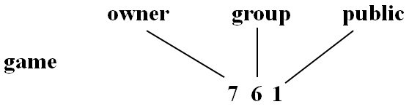
Access control
groups can be created and modified only by the manager or superuser.
Ask manager to create a group (unique name), say G, and add some users to the group.
For a particular file (say game) or subdirectory, define an appropriate access.
Change user’s access methods, e.g rwxr--r--
chmod G +w o=x file rwxrw---x
Attach a group to a file
chgrp G game.

Slide 50
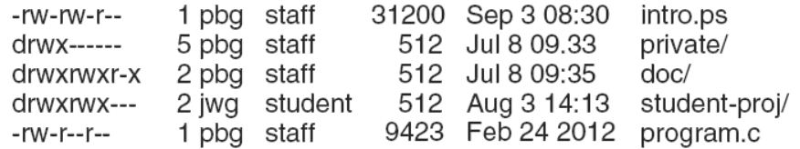
A Sample UNIX Directory Listing
d, directory
the number of links
owner
group
combining approaches, when the optional ACL permissions are set on a file. E.g. Solaris
commands, setfacl and getfacl, is used to manage the ACLs.
when permission and ACLs conflict, ACLs precedence.
general rule -- specificity should have priority.

Slide 51
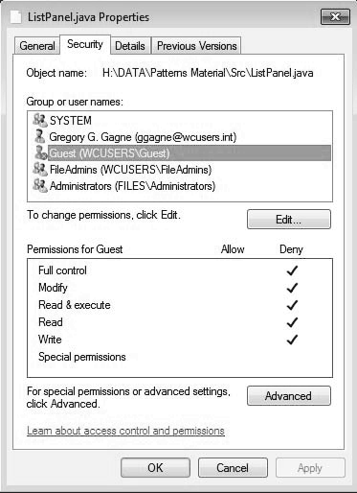
Windows Access-control List Management

Slide 52

作业及研究性学习
作业
理解打开文件表的作用
理解文件操作
研究性学习
思考存储介质对文件访问方式的影响
了解Linux/Windows操作系统中的文件保护机制

